Slide 1




Welcome to our class
Let’s have fun!

Slide 2
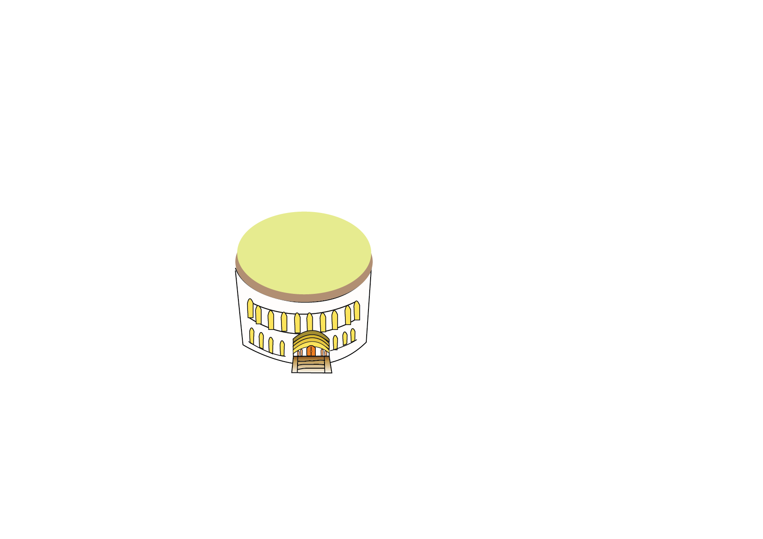




Hello

Slide 3




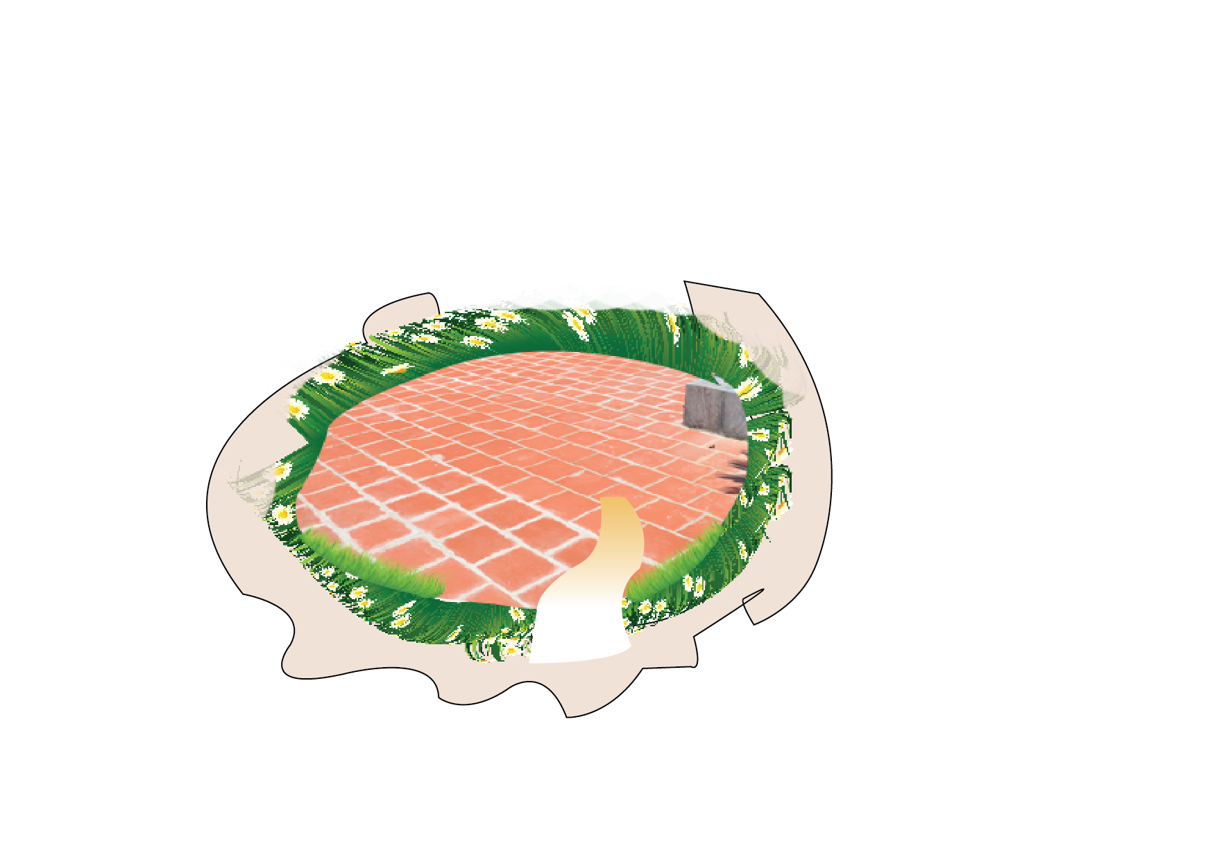
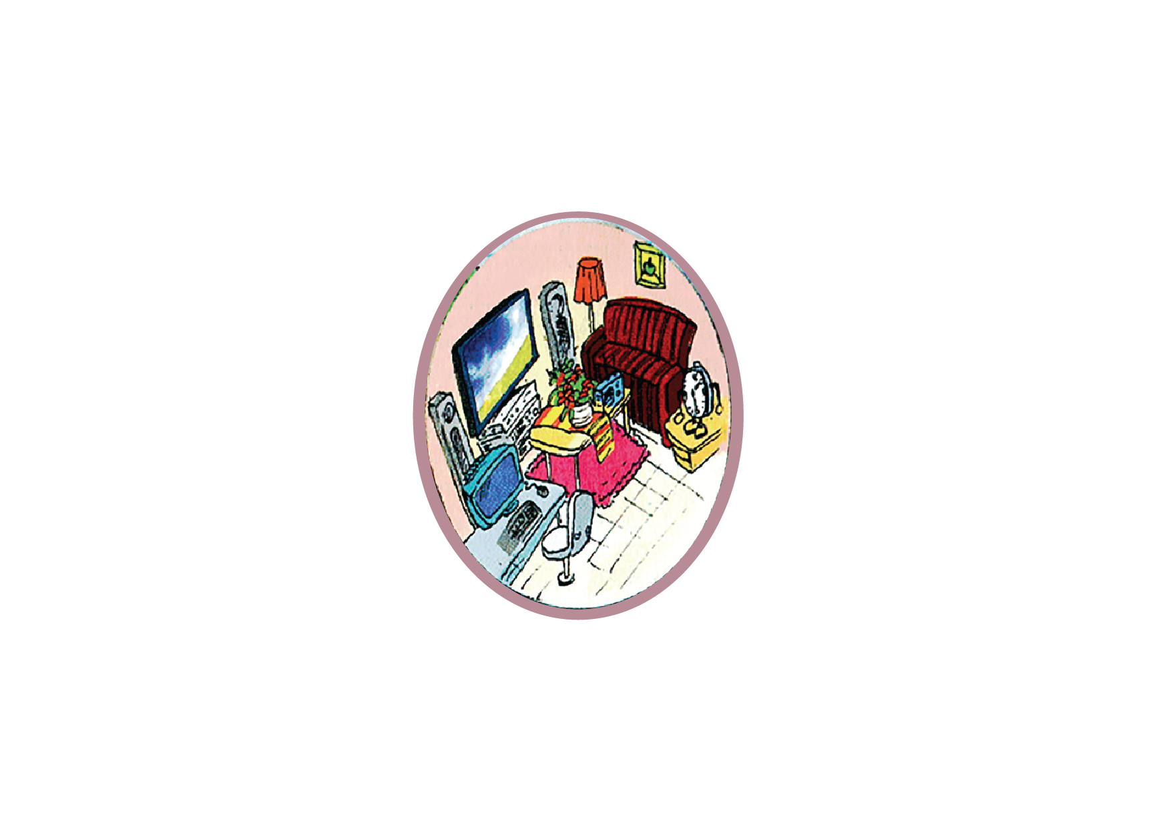





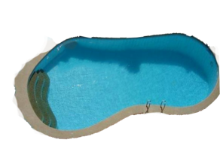



Slide 4
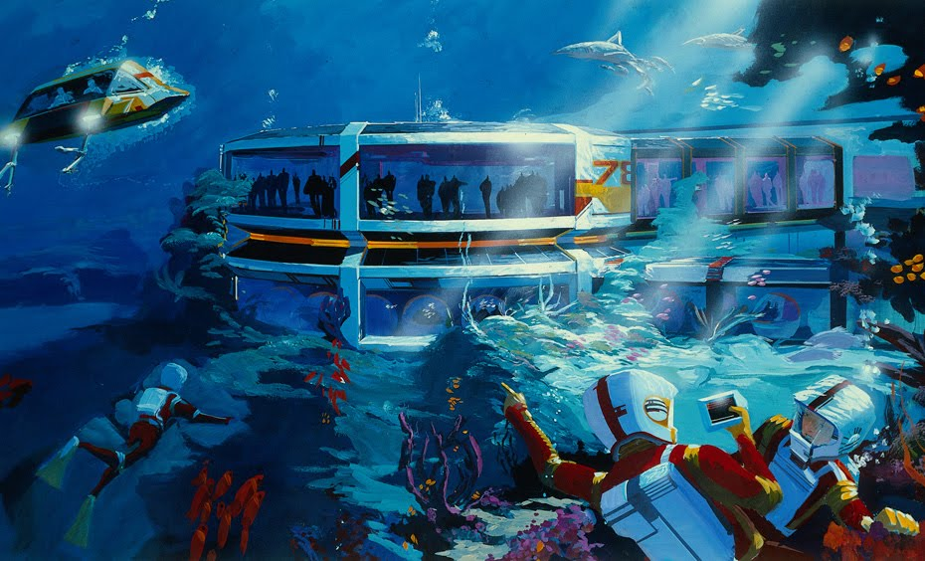


UNIT 10: OUR HOUSES IN THE FUTURE
LESSON 5 – SKILL 1

Slide 5
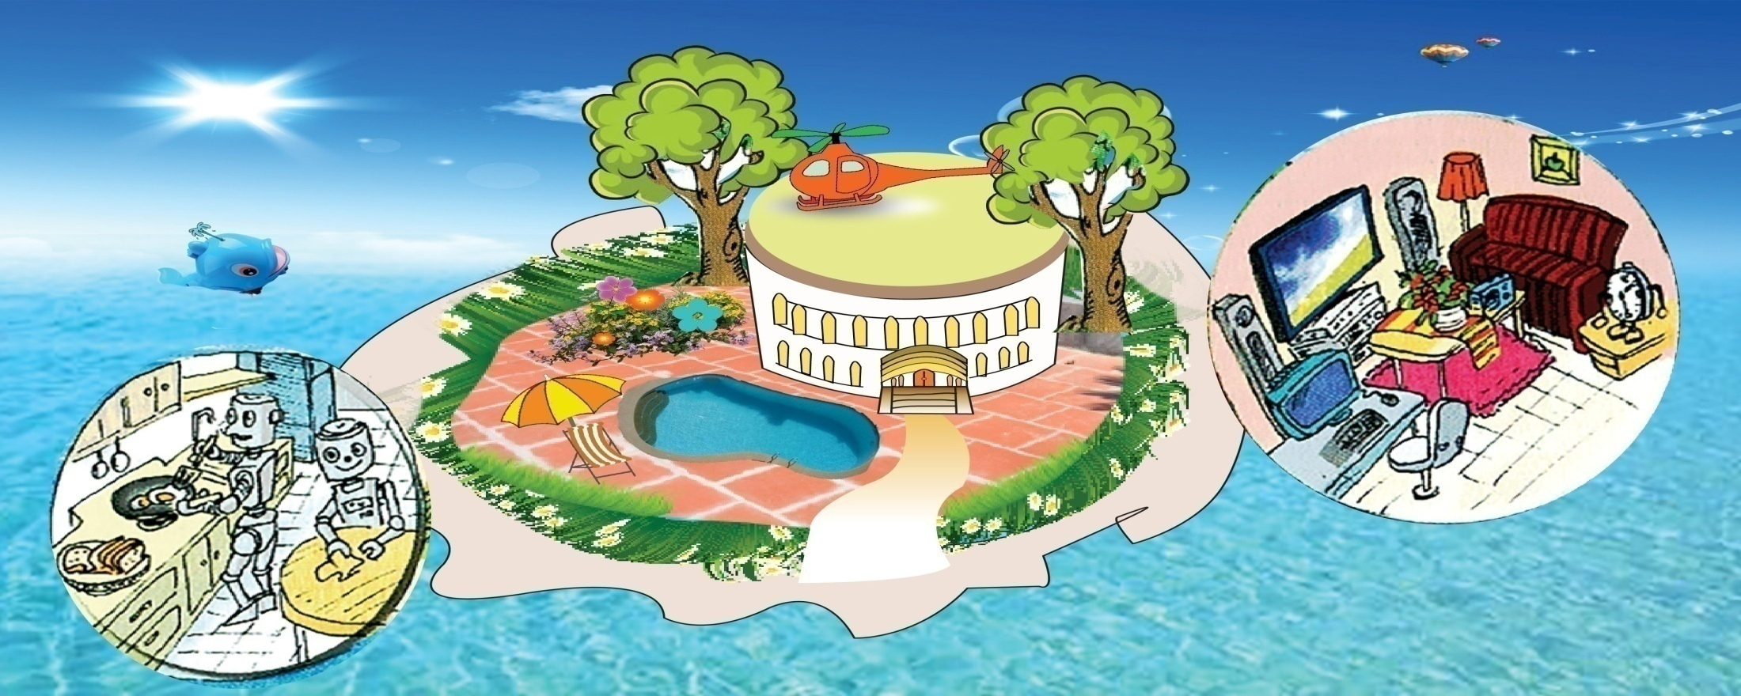
1. What type of house do you think it is?
2. Where do you think the house is?
3. What can you see around the house?
4. What can you see in the house?

Slide 6
Exercise 2. Read the text and match the phrases in A with the correct ones in B.
B
a. clean the floors
b. contact my friends
c. wash clothes
d. order food from the supermarket
e. cook meals
f. send and receive my e-mails
g. surf the Internet
h. water the flowers
A
1. The house will have robots to
robots
2. The house will have a super smart TV to
super smart TV

Slide 7
Exercise 3. Read the passage again and answer the questions:
1. Where will the house be located?
=> It will be on the ocean.
/ It will be located on the ocean.
2. What will there be in front and behind the house?
=> There will be a swimming pool in front and a flower garden behind the house.
3. Will the house have wind energy?
=> No, it won’t.
4. What will the robots do?
=> The robots/ They will do the housework (such as cleaning the floor, cooking meals, washing clothes, watering the flowers and feeding the dogs and cats).

Slide 8


Slide 9

on the moon
by the sea
Location
under the ground
trees
Around the house
garden
swimming pool
blue sea
In the house
rooms
smart TV
appliances
robots

Slide 10
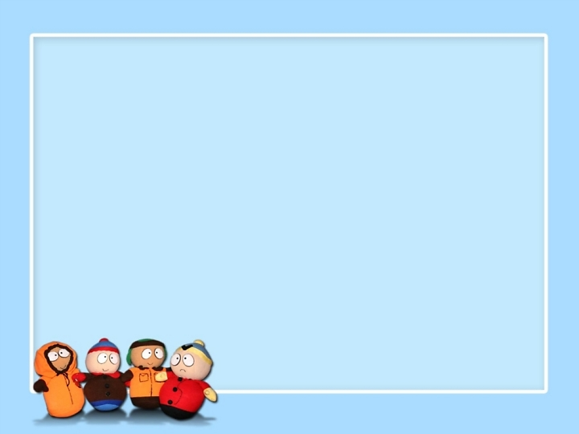
HOMEWORK
Draw a picture of your future house and write a passage about it.
2. Learn new words.
3. Prepare Unit 10. Lesson 6: Skill 2

Slide 11

Thank you for your attendance and goodbye!

Slide 12
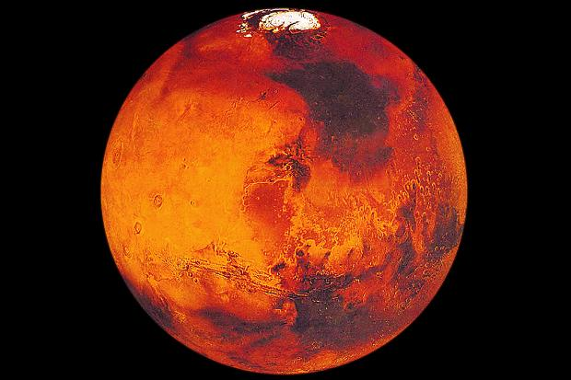

mars
My future house will be on the Mars.
There will be many tall trees around my house.
My future house will be surrounded by many tall trees.
My future house will be located on the Mars.

Slide 13
My future house will be on the Ocean. It will be surrounded by tall trees and blue sea. There will be a swimming pool in front and a large flower garden behind the house. There will be a helicopter on the roof so that I can fly to school.
My future house will have solar energy. There will be some robots in the house. They will help me do the housework, such as: cleaning the floors, cooking meals, washing clothes, watering the flowers and feeding the dogs and cats.
I will have a super smart TV in my house. It will help me surf the Internet, send and receive my e-mails, and contact my friends on other planets. It will also help me order food from the supermarket.

Slide 14


